Slide 1

Twitter Sentimental Analysis
Group number:- 01

Slide 2
Group Members
Name | Roll Number
Prathamesh Chikane | 06
Subodh Halpatrao | 18
Sutej Kulkarni | 35

Slide 3
What is Sentiment Analysis?
It is classification of the polarity of a given text in the document, sentence or a phrase
The goal is to determine whether the expressed opinion in the text is positive, neutral or negative.

Slide 4
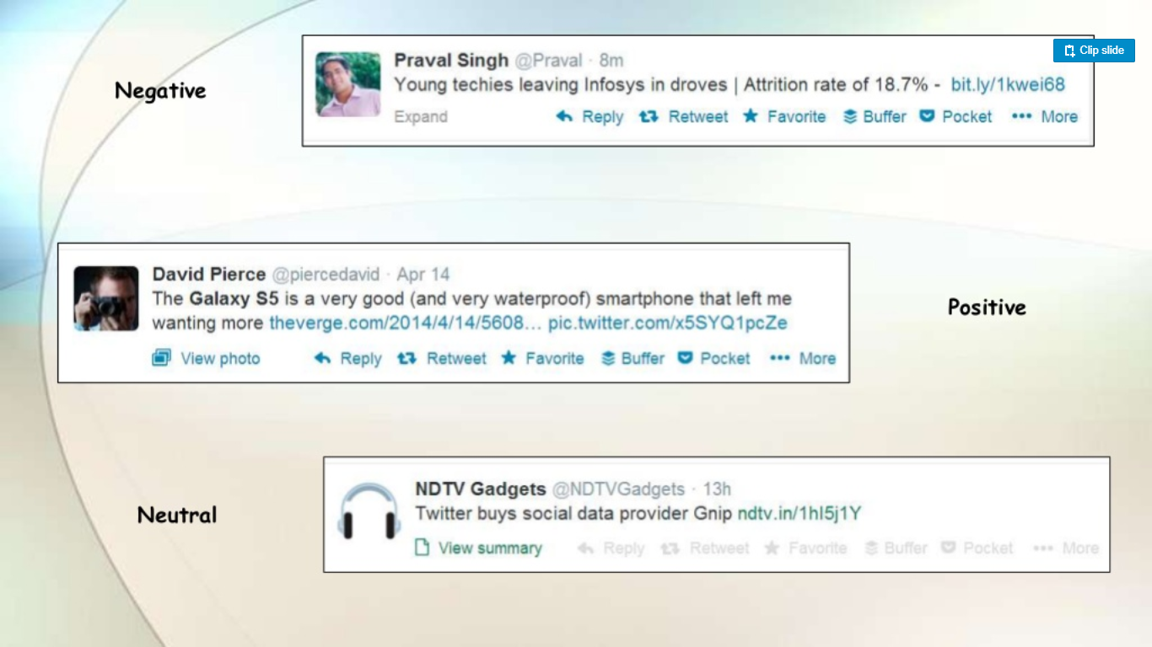

Slide 5
Why is Sentiment Analysis Important ?
Microblogging has become popular communication tool
Opinion of the mass is important
Political party may want to know whether people support their program or not.
Before investing into a company, one can leverage the sentiment of the people for the company to find out where it stands.
A company might want to find out the reviews of its products

Slide 6
Using Twitter for Sentiment Analysis
Popular microblogging site
240+ million active users
Twitter audience varies from common people to celebrities
Users often discuss current affairs and share personal views on various subjects
Tweets are small in length and hence unambiguous

Slide 7
Problem Statement
The problem statement at hand consists of two subtasks:
Phrase Level Sentiment Analysis in Twitter:
Given a message containing a marked instance of a word or a phrase, determine whether that instance is positive, negative or neutral in that context.
Sentence Level Sentiment Analysis in Twitter:
Given a message, decide whether the message is of positive, negative or neutral sentiment. For messages conveying both a positive and negative sentiment, whichever is the stronger sentiment should be chosen

Slide 8
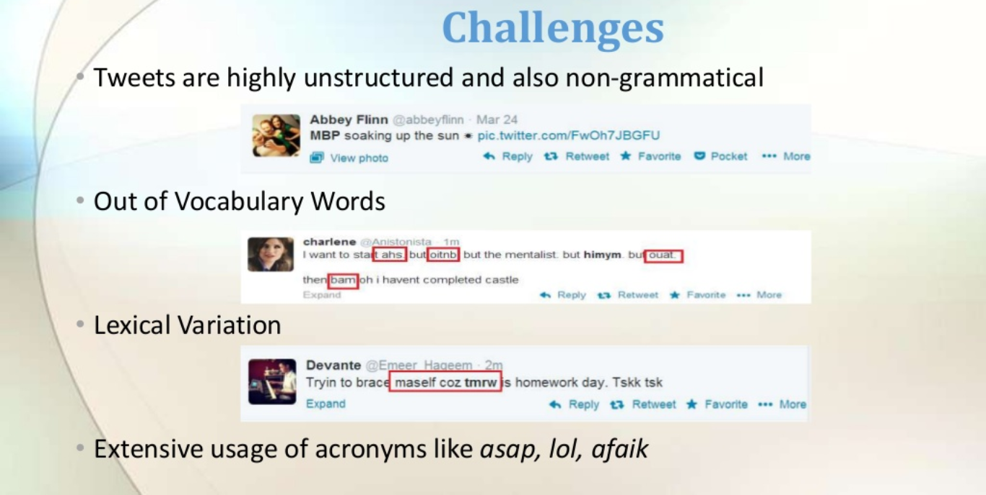

Slide 9
Approach
Tweet Downloader
Tokeniser
Preprocessing
Feature Extractor
SVM / Naïve Bayes Classifier & Prediction

Slide 10
Approach
Tweet Downloader
Download the tweets using Twitter API
Tokenisation
Twitter specific POS tagger developed by Social Media Search
Preprocessing
Removing Non-English Tweets, Replacing Emoticons by their polarity, Remove URL, Target Mentions, Hashtags
Remove Nouns and Prepositions, Replace sequence of repeated characters.

Slide 11
Approach
Feature Extractor > Polarity Score of the tweet > Percentage of capitalised words > Number of positive/negative capitalised words > Number of positive/negative hashtags > Number of negations
Classifier and Prediction
The Feature extracted are next passed on to SVM / Naïve Bayes classifier
The Model built is used to predict the sentiment of the tweets.

Slide 12
Design Plan
Dataset
query
Batch view
NLP Tools
query
Batch view
ML Components
Twitter Data
Real time view
Real time view

Slide 13
Implementation Plan
Here’s what our Implementation plan will look like:
Gather relevant tweets from Twitter
Preprocessing (stopword removal)
Applying the right sentiment analysis algorithm
Analyze the results
Discuss further improvement and next steps

Slide 14
Extracting Tweets
We’ll start by grabbing the tweets we want from Twitter, In one of the later stages, we will be extracting numeric features from our Twitter text data. This feature space is created using all the unique words present in the entire data. So, if we preprocess our data well, then we would be able to get a better quality feature space.

Slide 15
Pre-processing Tweets
The preprocessing of the text data is an essential step as it makes the raw text ready for mining, i.e., it becomes easier to extract information from the text and apply machine learning algorithms to it. If we skip this step then there is a higher chance that you are working with noisy and inconsistent data. The objective of this step is to clean noise those are less relevant to find the sentiment of tweets such as punctuation, special characters, numbers, and terms which don’t carry much weightage in context to the text.
Stopwords are words that aren’t integral to the meaning of a text, and are usually removed as part of a Natural Language Processing workflow. The tweets are now reassembled as sentences, but without stopwords removing these extra elements should give the sentiment analysis algorithm a better shot.

Slide 16
Applying the right sentiment analysis algorithm
Choosing which sentiment algorithm to use depends on a number of factors: you need to take into account the required level of detail, speed, cost, and accuracy among other things.
Following are the 2 algorithms shortlisted by us:
Naïve Bayes
Support Vector Machine

Slide 17
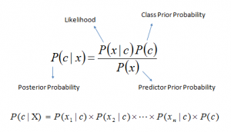
Naïve Bayes Algorithm
It is a classification technique based on Bayes’ Theorem with an assumption of independence among predictors. In simple terms, a Naive Bayes classifier assumes that the presence of a particular feature in a class is unrelated to the presence of any other feature Naive Bayes model is easy to build and particularly useful for very large data sets. Along with simplicity, Naive Bayes is known to outperform even highly sophisticated classification methods, Bayes theorem provides a way of calculating posterior probability P(c|x) from P(c), P(x) and P(x|c). Look at the equation below:

Slide 18
How Naive Bayes algorithm works?
Step 1: Convert the data set into a frequency table
Step 2: Create Likelihood table by finding the probabilities
Step 3: Now, use Naive Bayesian equation to calculate the posterior probability for each class. The class with the highest posterior probability is the outcome of prediction.

Slide 19
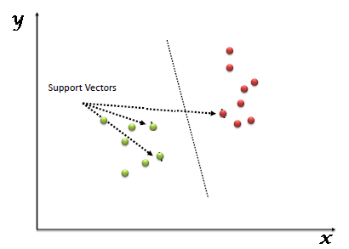
Support Vector Machine (SVM)
“Support Vector Machine” (SVM) is a supervised machine learning algorithm which can be used for both classification or regression challenges. However, it is mostly used in classification problems. In the SVM algorithm, we plot each data item as a point in n-dimensional space (where n is number of features you have) with the value of each feature being the value of a particular coordinate. Then, we perform classification by finding the hyper-plane that differentiates the two classes very well

Slide 20
How SVM Works?
Unlike other classifiers, the support vector machine is explicitly told to find the best separating line. How? The support vector machine searches for the closest points, which it calls the "support vectors" (the name "support vector machine" is due to the fact that points are like vectors and that the best line "depends on" or is "supported by" the closest points).
Once it has found the closest points, the SVM draws a line connecting them. It draws this connecting line by doing vector subtraction (point A - point B). The support vector machine then declares the best separating line to be the line that bisects -- and is perpendicular to -- the connecting line.
The support vector machine is better because when you get a new sample (new points), you will have already made a line that keeps B and A as far away from each other as possible, and so it is less likely that one will spillover across the line into the other's territory.

Slide 21
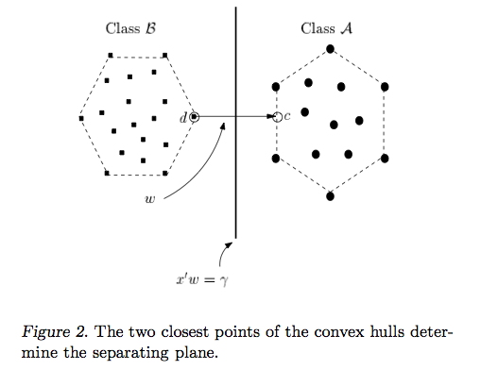

Slide 22
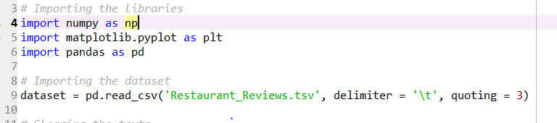
Naïve Bayes implementation
.

Slide 23
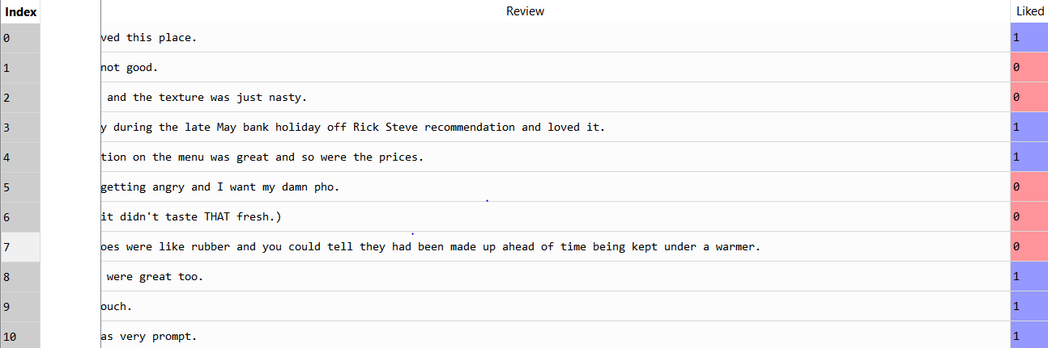
TSV tweets dataset
CSV after coverted into TSV.

Slide 24
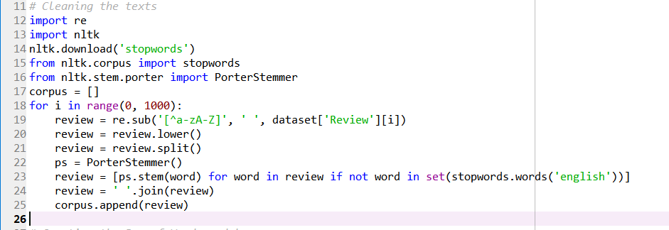
Text Cleaning and creating a corpus
.

Slide 25
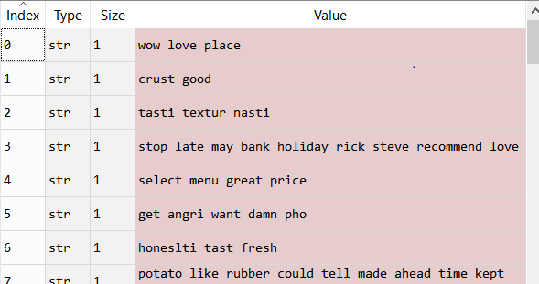
Corpus of tweets

Slide 26
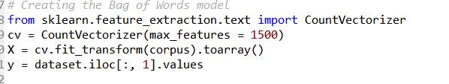
Creating Bag of Words

Slide 27
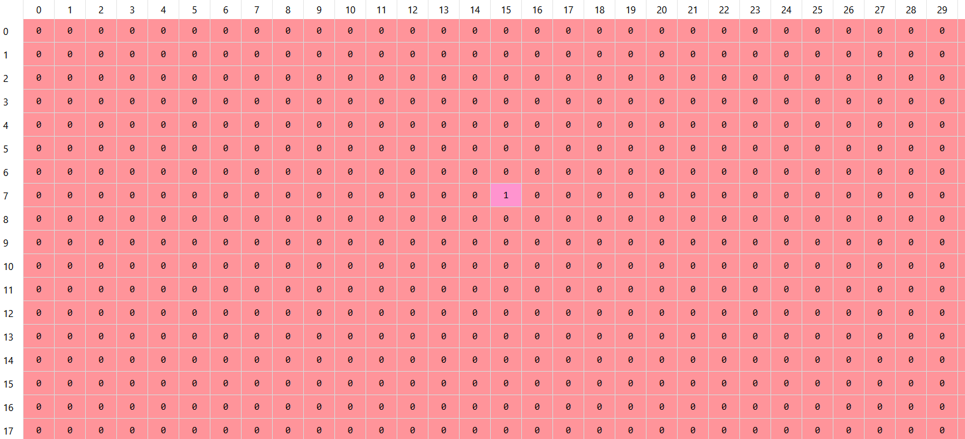
Bag of words

Slide 28
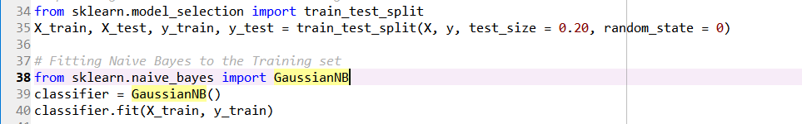
Splitting and training

Slide 29
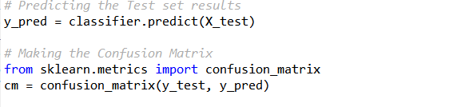
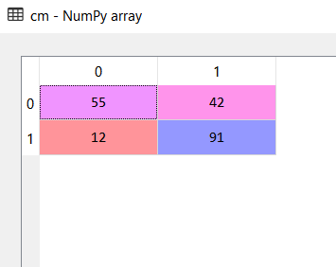
Prediction and confusion matrix

Slide 30
Accuracy
Total tweets considered for testing is 200.
Correct predictions are 146.hence accuracy is (146/200) x100=73%
Accuracy is 73%.

Slide 31
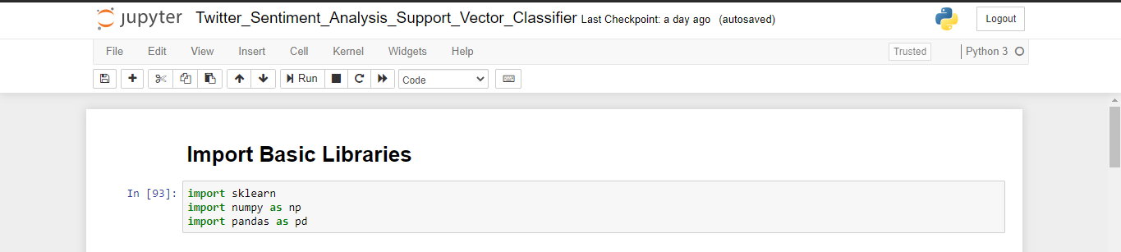
SVM Implementation

Slide 32
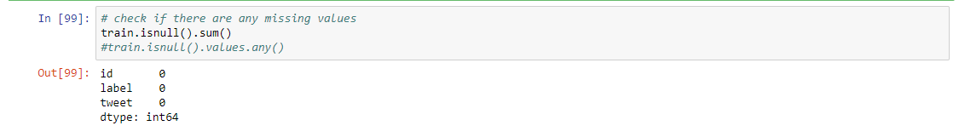

Slide 33
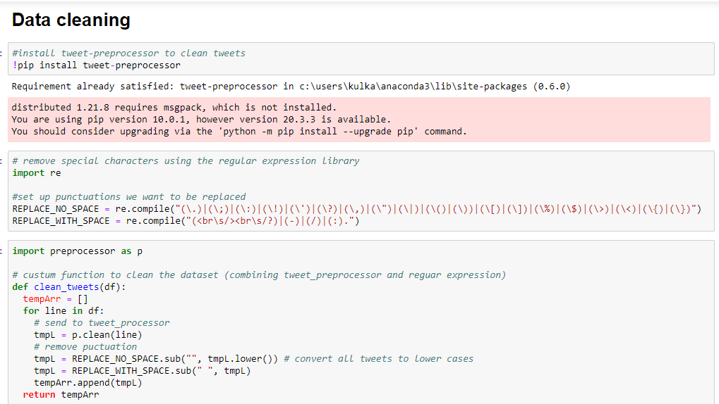

Slide 34
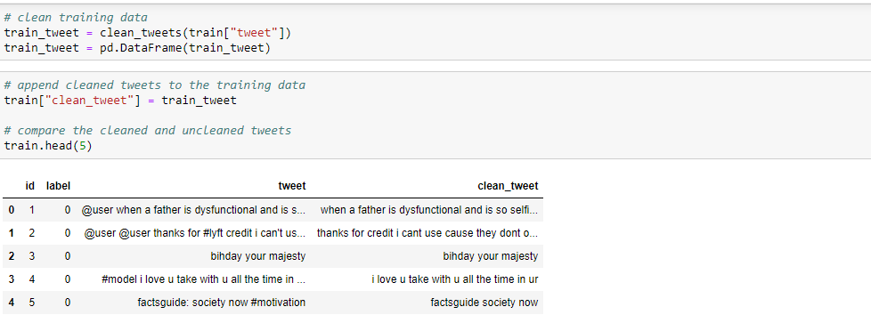

Slide 35
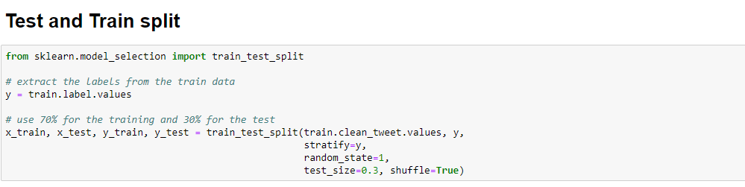

Slide 36
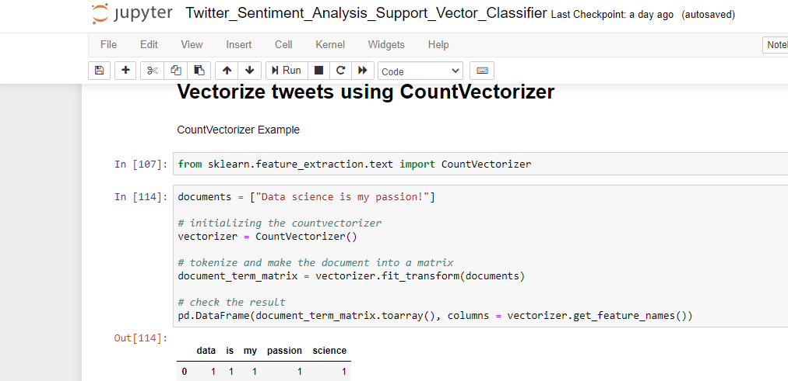

Slide 37
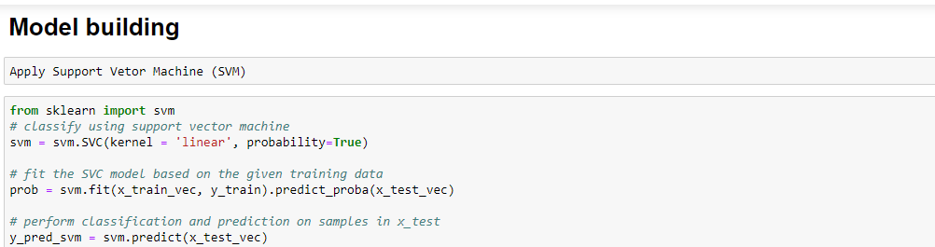

Slide 38
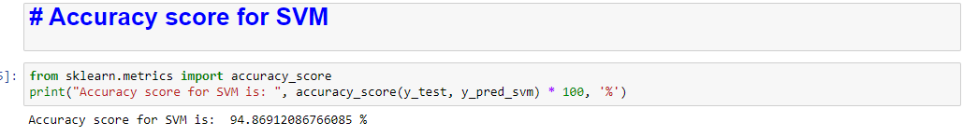

Slide 39
Further Improvements and Next Steps
There are a few ways we can improve this pipeline to make it look more like something production ready.
Gather (a lot) more tweets – the more tweets we have, the more confident we can be in our sentiment estimation.
Explore other algorithms – depending on the business goal, other algorithms might be better suited to this type of analysis. For example, the TextBlob Python package returns a measure of subjectivity for a given string of text.
Making a web model of the project with real time input of text and classification of its sentiment.

Slide 40
CONCLUSION
From our research we have concluded that Naive Bayes and Support Vector Machine are two of the best approach for our project, After analysing the final result of both of them the best of either two algorithm is SVM and the same will be selected for our further process.

